Slide 1

离散数学
Discrete Mathematics
钟芳明
离散数学
Discrete Mathematics

Slide 2
Review
Intersection and Union of Set
Difference of Set
Symmetric Difference of Set
40 laws of set operation
Principle of Inclusion-exclusion
Euler function

Slide 3
Chapter 4 Binary Relation

Slide 4
Contents
The relations discussed in this chapter (mainly binary relations) are still a set, but it is a more complex set than in the previous chapter.
The relation is a subset of the Cartesian product, and its elements are in the form of ordered binary tuples (pairs). The two elements of these ordered binary tuples come from two different or the same sets. Therefore, a relation is a set based on other sets.
The ordered binary tuples in a relation reflects the relationship between elements in different sets or between elements in the same set.
In this chapter, we first discuss the basic expressions of relations, then we give the operations of relations, and finally, we discuss several commonly used relations.

Slide 5
Contents
Set
Sub Set
Union, Intersection
Complement Difference
Ordered Pair
Power Set
Cartesian Products
Relations
Function
Reflexive, Symmetric, Transitive
Injection, Onto, Bijection

Slide 6
Contents
Ordered couple and Cartesian product
Basic concepts of relations
Properties of relations
Representation of relations
Operation of relationships
Relations graph and matrix
Specific relations：equivalence relations and partition, compatibility relation and covering, partial ordering relation and Haust.

Slide 7
Chapter 4 Binary Relation
4.1 Multiple ordered tuples and Cartesian product

Slide 8
Tuples (元组)
多重序元与笛卡尔乘积
元组
有序对
多重序元
笛卡尔乘积
关系的基本概念
关系的定义
相等
定义域和值域
关系的性质
The ordered n-tuple <a₁,a₂,…,a_{n}>is the ordered collection that
has a₁ as its first element
and a₂ as its second element
and so on until a_{n} as its last element.
Two tuples are equal if and only if their corresponding elements are equal.

Slide 9
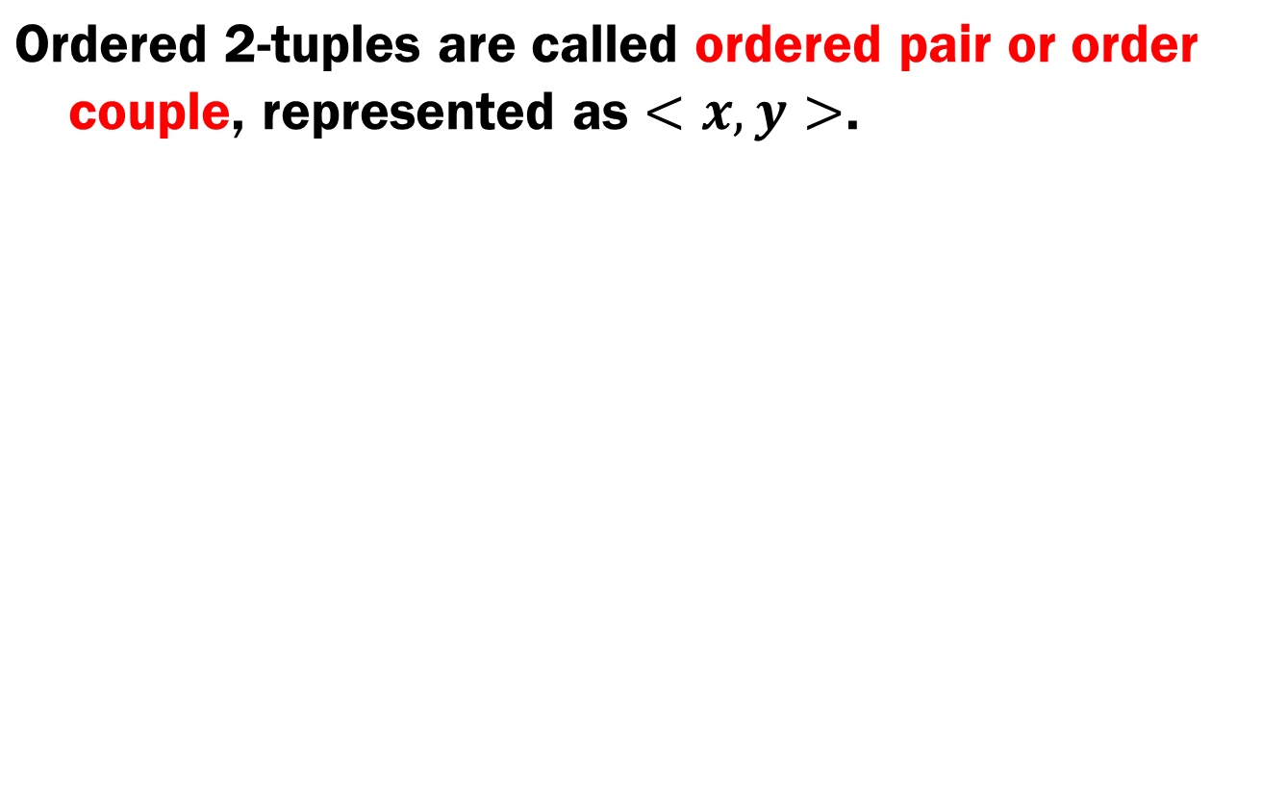
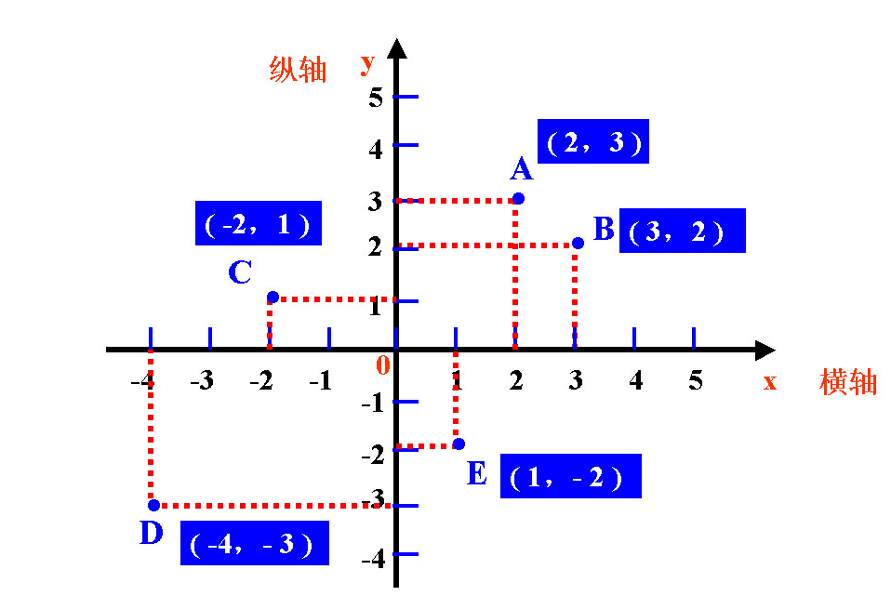
Ordered Pair (有序对)
多重序元与笛卡尔乘积
元组
有序对
多重序元
笛卡尔乘积
关系的基本概念
关系的定义
相等
定义域和值域
关系的性质
{2,3}={3,2}

Slide 10
Ordered pair
多重序元与笛卡尔乘积
元组
有序对
多重序元
笛卡尔乘积
关系的基本概念
关系的定义
相等
定义域和值域
关系的性质
Equality of ordered pairs ：
In the ordered pair < a, b >, a is called the first element, and b is called the second element.
Two elements do not necessarily come from the same set, they can represent different types of transactions.

Slide 11
Multiple ordered tuples (多重序元)
多重序元与笛卡尔乘积
元组
有序对
多重序元
笛卡尔乘积
关系的基本概念
关系的定义
相等
定义域和值域
关系的性质
Definition: n ordered tuple is an ordered pair, the first element of which is (n-1) order tuple.
3 order tuple ：<<x,y>,z>， Simple notation <x,y,z>
n order element ：<<x₁,x₂,…,x_{n-1}>,x_{n}>
Equality of n order element ：

Slide 12
Cartesian product (笛卡尔乘积)
多重序元与笛卡尔乘积
元组
有序对
多重序元
笛卡尔乘积
关系的基本概念
关系的定义
相等
定义域和值域
关系的性质
The Cartesian Product of two sets A and B, denoted by A×B is the set of ordered pairs <a, b> where a∈A and b∈B.
If there are m elements in A and n elements in B, the number of elements in the Cartesian product of A and B is?
m × n
Notes:
“+”是加号，“-”是减号，“×”是乘号，“÷”是除号

Slide 13
Cartesian product
多重序元与笛卡尔乘积
元组
有序对
多重序元
笛卡尔乘积
关系的基本概念
关系的定义
相等
定义域和值域
关系的性质

Slide 14
Cartesian product
多重序元与笛卡尔乘积
元组
有序对
多重序元
笛卡尔乘积
关系的基本概念
关系的定义
相等
定义域和值域
关系的性质
So：

Slide 15
Cartesian product
多重序元与笛卡尔乘积
元组
有序对
多重序元
笛卡尔乘积
关系的基本概念
关系的定义
相等
定义域和值域
关系的性质
Theorem: there are three sets of A，B and C, then

Slide 16
Cartesian product n sets
多重序元与笛卡尔乘积
元组
有序对
多重序元
笛卡尔乘积
关系的基本概念
关系的定义
相等
定义域和值域
关系的性质
Definition：the Cartesian product of the sets A₁,A₂,…,A_{n}
The Cartesian product of the set A is denoted as A² , and so on
If all sets A_{i} are finite sets, the cardinality of their Cartesian product is:

Slide 17
Chapter 4 Binary Relation
4.2 Basic concepts of relation

Slide 18
Basic concepts of relation
多重序元与笛卡尔乘积
元组
有序对
多重序元
笛卡尔乘积
关系的基本概念
关系的定义
相等
定义域和值域
关系的性质
Definition ： suppose n∈Z⁺ and A₁,A₂,…,A_{n} are n arbitrary sets,
(a) R is called the n-ary relation among A₁,A₂,…,A_{n} ；
(b) If n = 2, then R is the binary relation between A₁ and A₂. ；
(c) if R=∅ ， then R is called an empty relation；if ， then R is called total relation；
(d) If ， then R is called the n-ary relation on A.

Slide 19
Definition of relation
多重序元与笛卡尔乘积
元组
有序对
多重序元
笛卡尔乘积
关系的基本概念
关系的定义
相等
定义域和值域
关系的性质
Example ：
Then R₁ is a unary relation on N and R₂ is a binary relation on N. R₃ is a ternary relation over N.
In the absence of the extra specification, the term "relation" generally refers to a binary relation.
If the ordered pair <x,y> belongs to R, it is written as <x,y>∈R or xRy , otherwise, as <x,y>∉R or .

Slide 20
Definition of relation
多重序元与笛卡尔乘积
元组
有序对
多重序元
笛卡尔乘积
关系的基本概念
关系的定义
相等
定义域和值域
关系的性质
Example：suppose sets A={a,b},B={2,5,8}
so
let
then are the relation between A and B.
Let ，
Then is a relationship from B to A.
Let ，
Then is a relation on B.

Slide 21
Definition of relation
多重序元与笛卡尔乘积
元组
有序对
多重序元
笛卡尔乘积
关系的基本概念
关系的定义
相等
定义域和值域
关系的性质
Example：let A={2,3,5,9}, and give the relation of less than or equal to, and greater than or equal to on the set A.
Solution： let the relation of less than or equal to as R₁ on the set A and greater than or equal to as R₂, defined as:

Slide 22
Equality of relation
多重序元与笛卡尔乘积
元组
有序对
多重序元
笛卡尔乘积
关系的基本概念
关系的定义
相等
定义域和值域
关系的性质
Definition：Let R₁ be A₁,A₂,…,A_{n} n-ary relation, and R₂ be B₁, B₂,…,B_{m} m-ary relation，if
（1）n=m
（2）if ，then
（3）Define R₁ and R₂ as sets, R₁ = R_{2 .}
Then the n-ary relation R₁ and the m-ary relation R₂ are equal, and are denoted as R₁ = R₂.

Slide 23
Equality of relation
多重序元与笛卡尔乘积
元组
有序对
多重序元
笛卡尔乘积
关系的基本概念
关系的定义
相等
定义域和值域
关系的性质
Example：Let R₁ be a binary relation from N to Z⁺. Let R₂ and R₃ be binary relations on N.
From the point of set, R₁=R₂=R₃.
But as far as binary relations are concerned, R₂=R_{3 ,} not equal to R₁.

Slide 24
Domain(定义域) and range（值域） of relation
多重序元与笛卡尔乘积
元组
有序对
多重序元
笛卡尔乘积
关系的基本概念
关系的定义
相等
定义域和值域
关系的性质
The domain of relation R (the relation from A to B) is defined as：
dom(R)={x|∃y(<x,y>∈R)}
The range of relation R is defined as:
ran(R)={y|∃x(<x,y>∈R)}
A
B
2
2
6
3
7
Obviously, dom(R)⊆A, ran(R)⊆B
5
8
9
Example：let A={2,3,5},B={2,6,7,8,9}， The relation R from A to B is defined as: if and only if a can divide b, there is aRb
so:
dom(R)={2,3}
ran(R)={2,6,8,9}

Slide 25
Chapter 4 Binary Relation
4.4 Properties of relations

Slide 26
Properties of relation
多重序元与笛卡尔乘积
元组
有序对
多重序元
笛卡尔乘积
关系的基本概念
关系的定义
相等
定义域和值域
关系的性质
Definition: let R be a binary relation on A
(1)For every , there is ,
R is call reflexive（自反的）. Expressed in terms of
(2) For every ，there is
R is called antireflexive（反自反的） Expressed in terms of
R is antireflexive
The antireflexive relation is not the opposition of reflexive relation.

Slide 27
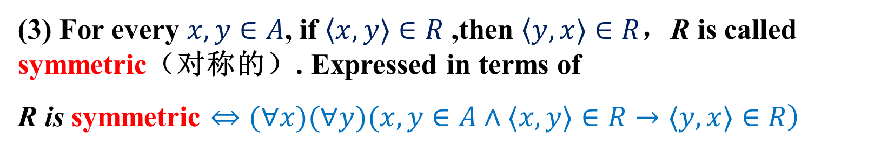
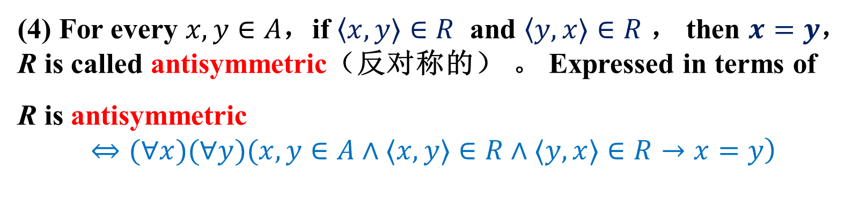
Properties of relation
多重序元与笛卡尔乘积
元组
有序对
多重序元
笛卡尔乘积
关系的基本概念
关系的定义
相等
定义域和值域
关系的性质
(3) For every $x,y∈A$, if $〈x,y〉∈R$ ,then $〈y,x〉∈R$，R is called symmetric（对称的）. Expressed in terms of
R is symmetric $\left.⇔(∀x)(∀y)(x,y∈A∧〈x,y〉∈R→〈y,x〉∈R\right)$
(4) For every $x,y∈A$，if $〈x,y〉∈R$ and $〈y,x〉∈R$ ， then $x=y$， R is called antisymmetric（反对称的） 。 Expressed in terms of
R is antisymmetric
$$\left.⇔(∀x)(∀y)(x,y∈A∧〈x,y〉∈R∧〈y,x〉∈R→x=y\right)$$

Slide 28
Properties of relation
多重序元与笛卡尔乘积
元组
有序对
多重序元
笛卡尔乘积
关系的基本概念
关系的定义
相等
定义域和值域
关系的性质
(5) For every ,if and ， then ，R is call transitive（可传递的）. Expressed in terms of :
R is transitive
(6) Exist ，and but ， R is call not transitive. Expressed in terms of :
R is not transitive （不可传递的）

Slide 29
Properties of relation
多重序元与笛卡尔乘积
元组
有序对
多重序元
笛卡尔乘积
关系的基本概念
关系的定义
相等
定义域和值域
关系的性质
Example 1： Consider the properties of general equality relation“=”， greater than relation“>” and greater than or equal to relation“ ”on the set of natural numbers
Answer ：
(1) “=” is reflexive, symmetrical, antisymmetric, transitive;
(2)“>” is antireflexive, antisymmetric, and transitive;
(3)“ ” is reflexive, antisymmetric, transitive.
Example 2：The properties of binary relations on empty sets.
Reflexive, symmetric, antisymmetric, antireflexive, transitive

Slide 30
Empty relation VS empty relation on empty sets
多重序元与笛卡尔乘积
元组
有序对
多重序元
笛卡尔乘积
关系的基本概念
关系的定义
相等
定义域和值域
关系的性质
Empty relation (空关系) ： for any set A, empty set is called an empty relation on A.
Property:
If A is not empty, empty relation on A is antireflexive, symmetric, antisymmetric, transitive;
If A is an empty set, the empty relation on A is reflexive, antireflexive, symmetric, antisymmetric, transitive.
Relations on empty sets (空集上的关系) : reflexive, antireflexive, symmetric, antisymmetric, transitive.
Arbitrary meta-relations can be defined on empty sets.
Notes:
既然是空关系，而且是有元素的，那么说明自己跟自己没有关系，也就是反自反的。
都互相没有关系，所以是对称的

Slide 31
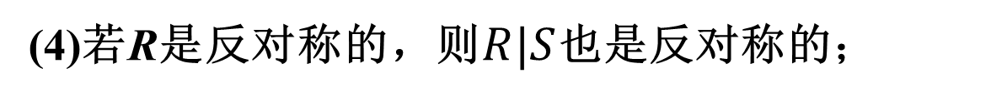
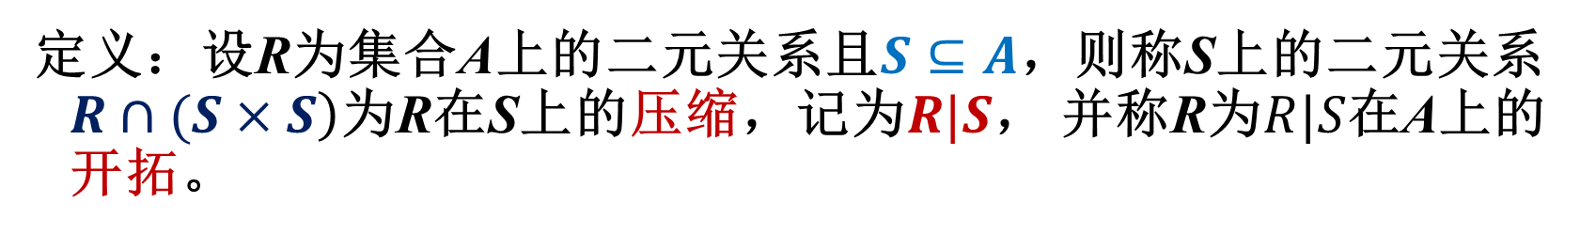
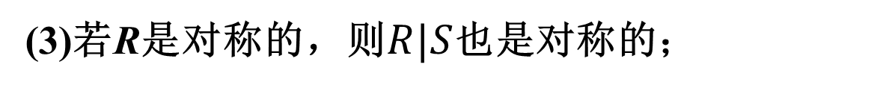
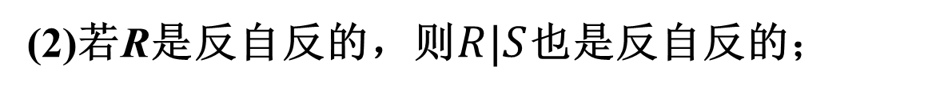
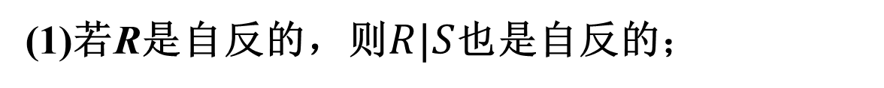

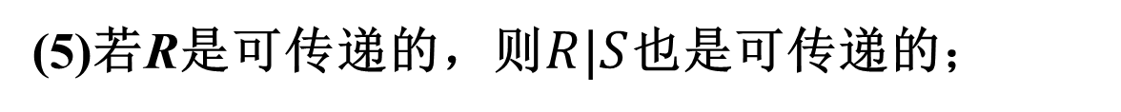
集合的压缩和开拓
关系的性质
关系的表示
关系图
关系矩阵
关系的运算
合成
幂
逆
闭包
定义：设R为集合A上的二元关系且$S⊆A$，则称S上的二元关系$\left.R∩(S×S\right)$为R在S上的压缩，记为$R|S$， 并称R为$R|S$在A上的开拓。
定理：设R为A的二元关系且$S⊆A$，那么：
(1)若R是自反的，则$R|S$也是自反的；
(2)若R是反自反的，则$R|S$也是反自反的；
(3)若R是对称的，则$R|S$也是对称的；
(4)若R是反对称的，则$R|S$也是反对称的；
(5)若R是可传递的，则$R|S$也是可传递的；

Slide 32
Homework
P102：1-10 （ odd number of each question）

Slide 33

The End
Thanks

